Slide 1




GEMOC modeling crash course
---An introduction to EMF tooling ---
2017
Didier Vojtisek (Inria)
http://people.rennes.inria.fr/Didier.Vojtisek/
Didier.vojtisek@inria.fr
Benoit Combemale (Inria & Univ. Rennes 1)
http://people.irisa.fr/Benoit.Combemale
benoit.combemale@irisa.fr
@bcombemale

Slide 2
Course main purpose
see how EMF+GEMOC technologies helps to (semi-automatically) build the tooling for a DSL IDE

Slide 3
Course content
Part 1. General introduction
Modeling/Language
DSL
Technology introduction
Eclipse
Ecore
OCL
Xtext
Sirius
Melange
GEMOC model debugger
Part 2. Hands on
Finite State Machine example
Part 3. Scaling up - Going further
Concurrency
Coordination

Slide 5
What is a language?
« A system of signs, symbols, gestures, or rules used in communicating »
« The special vocabulary and usages of a scientific, professional, or other group »
« A system of symbols and rules used for communication with or between computers. »

Slide 6
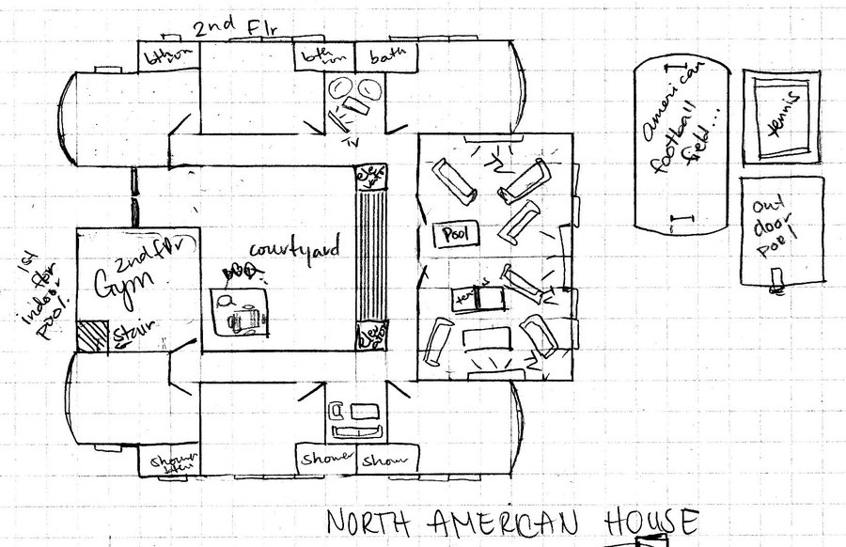
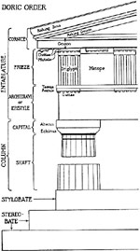
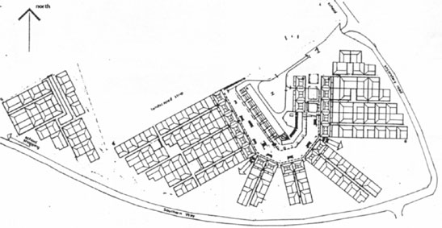
Architecture
Architecture

Slide 7
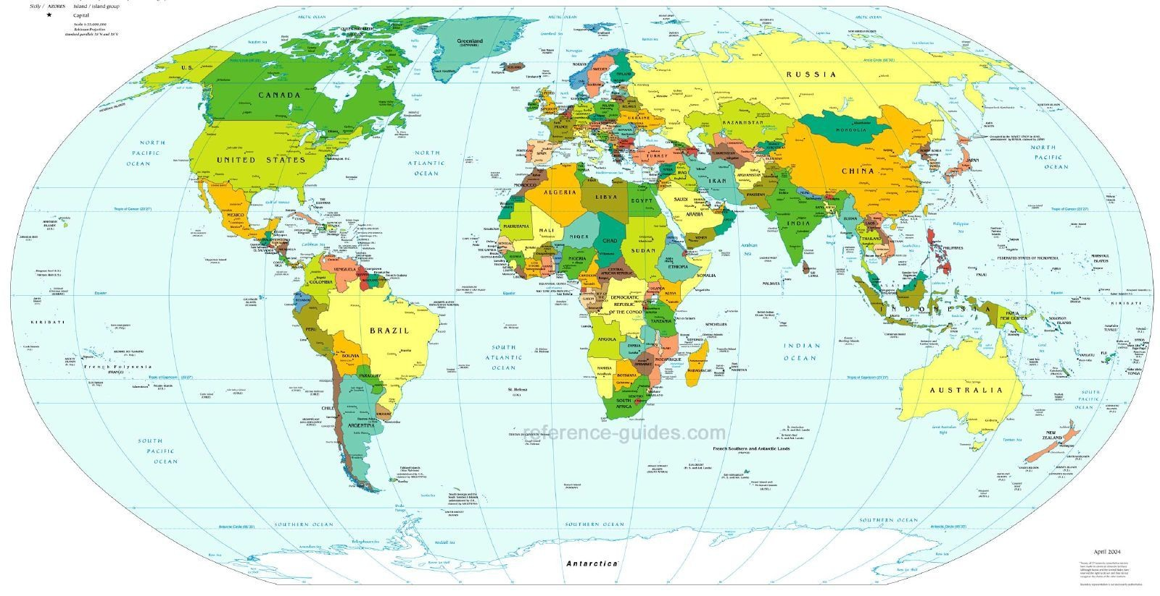
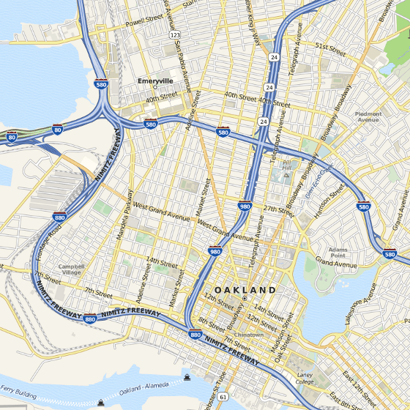
Cartography
Cartography

Slide 8
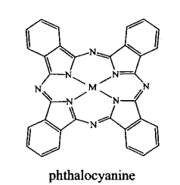
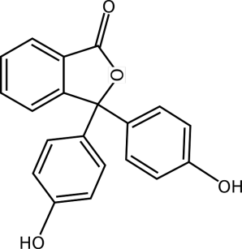
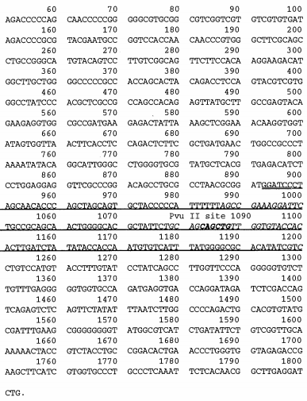
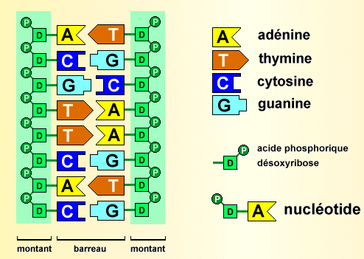
Biology
Biology

Slide 9
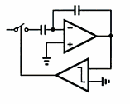
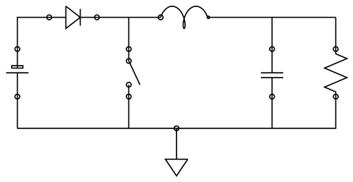
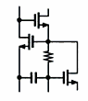
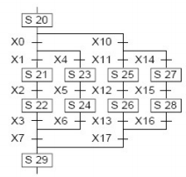
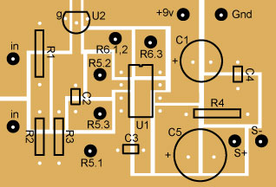
Electronics
Electronics

Slide 10
In Software Engineering
« Languages are the primary way in which system developers communicate, design and implement software systems »

Slide 11
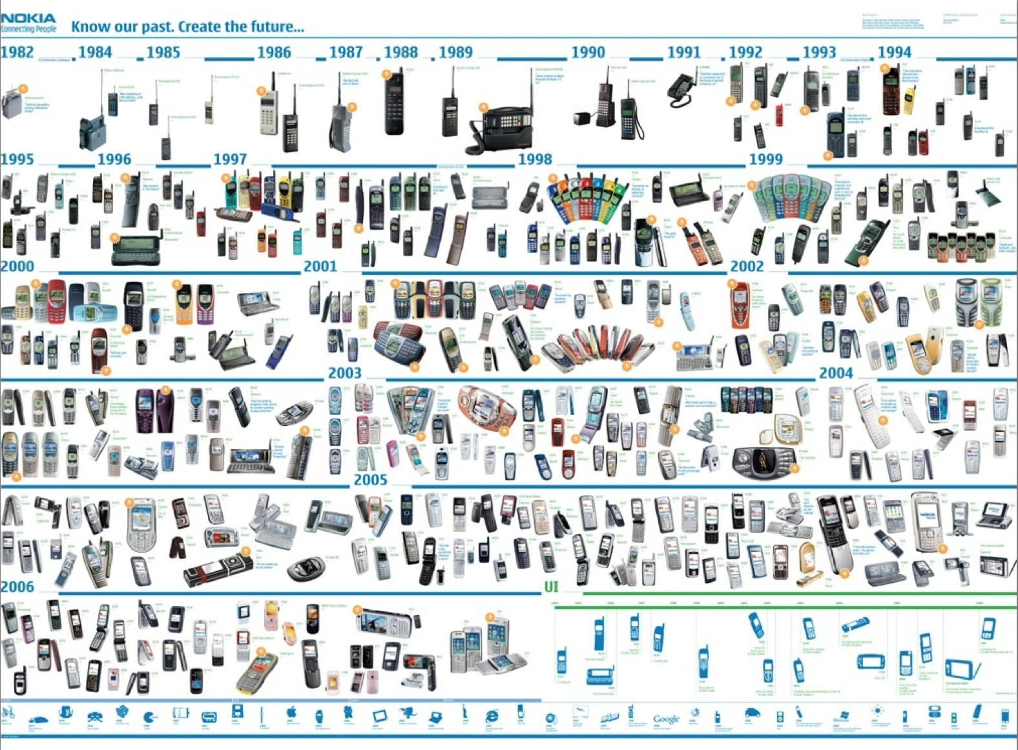





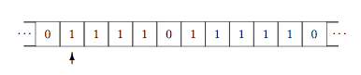
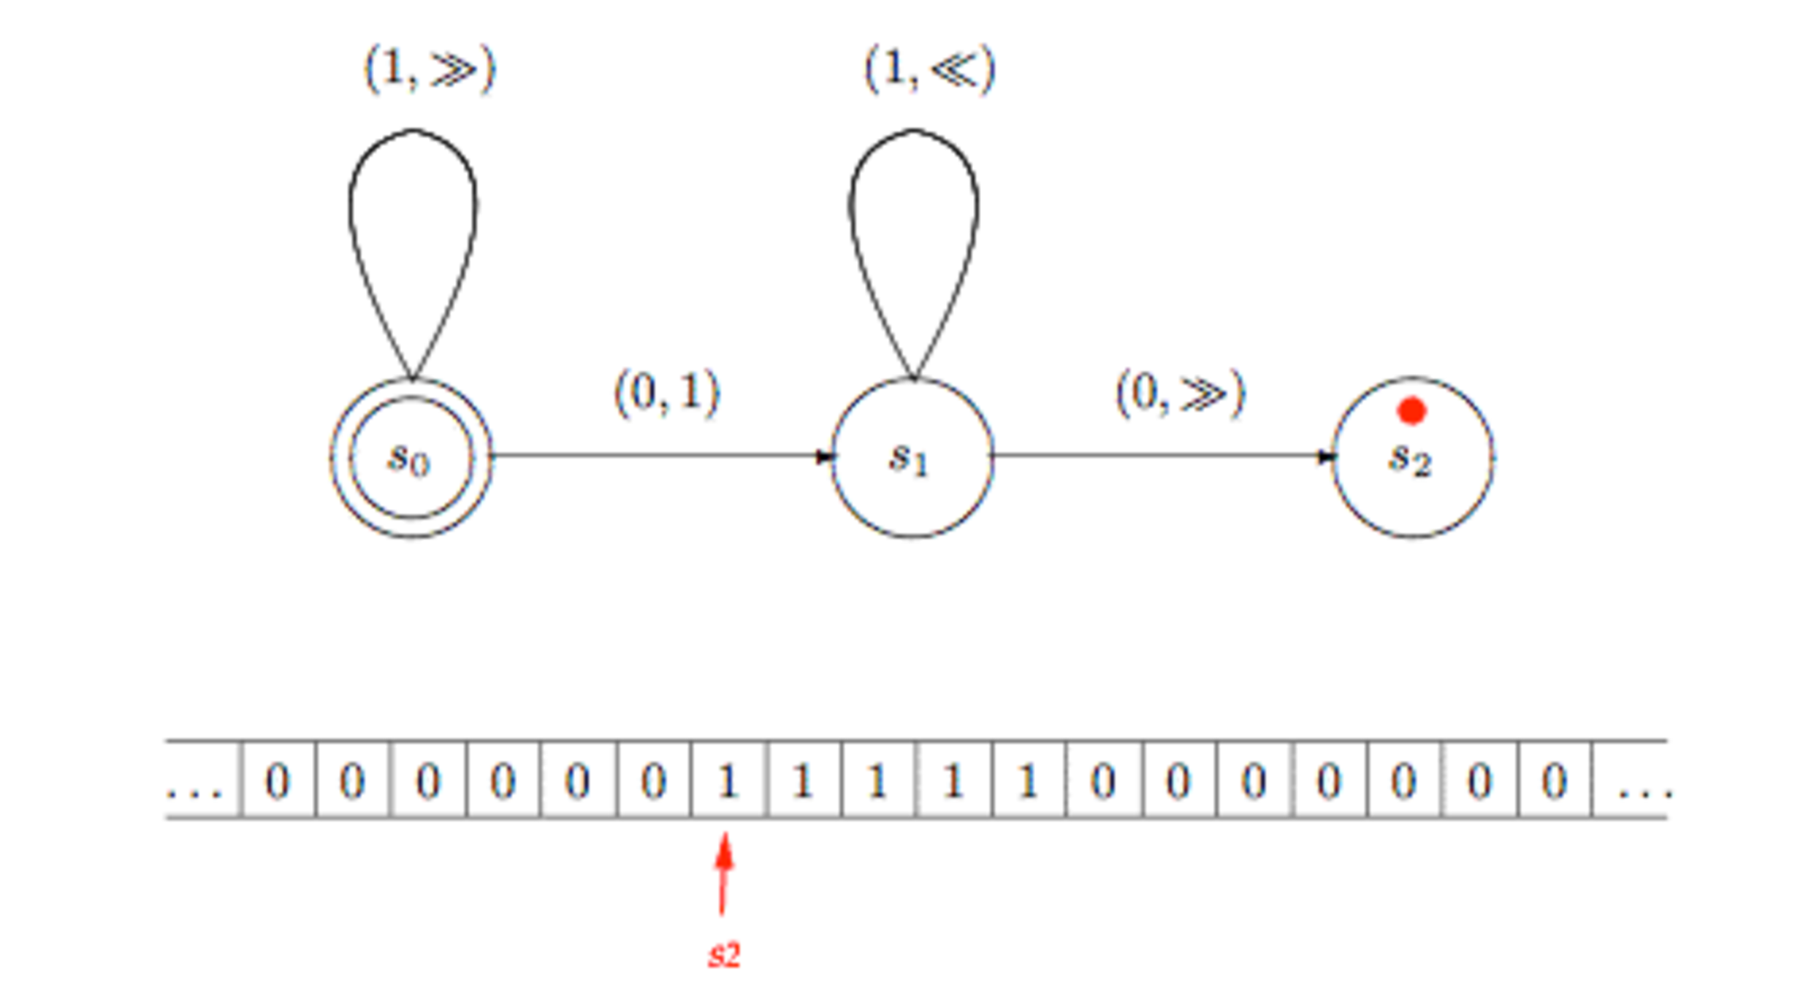
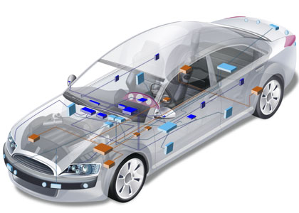

General Purpose
Languages
Assembly ?
COBOL ? LISP ? C ? C++ ?
Java? PHP ? C# ? Ruby ?
Notes:
http://plato.stanford.edu/entries/turing-machine/

Slide 12
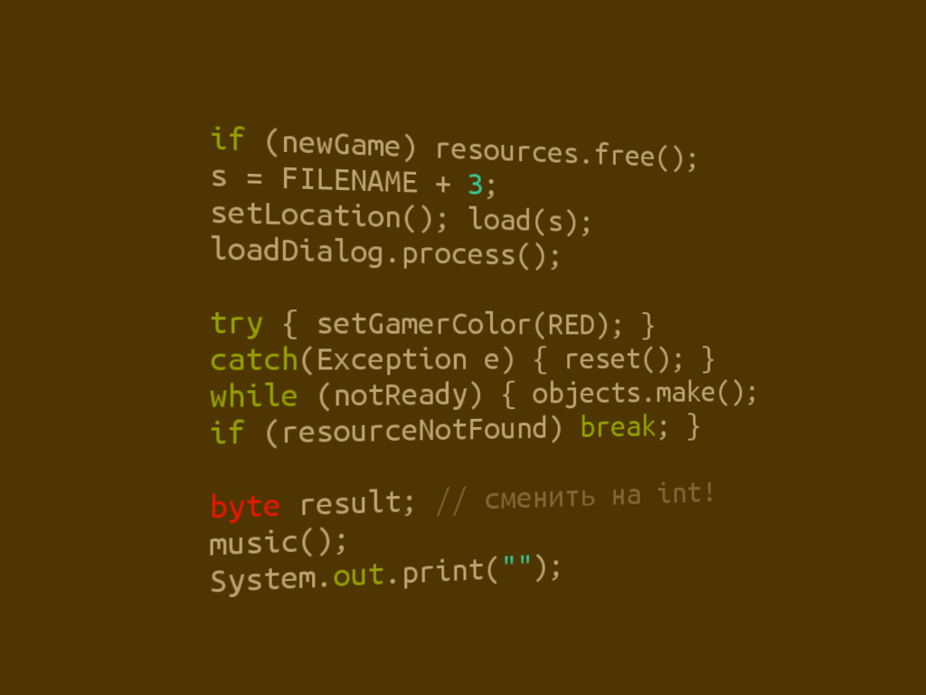
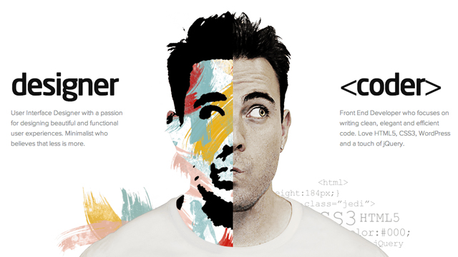
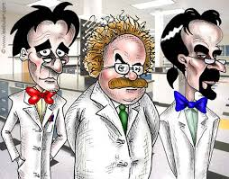

Limits of General Purpose Languages (1)
Abstractions and notations used are not natural/suitable for the stakeholders

Slide 13

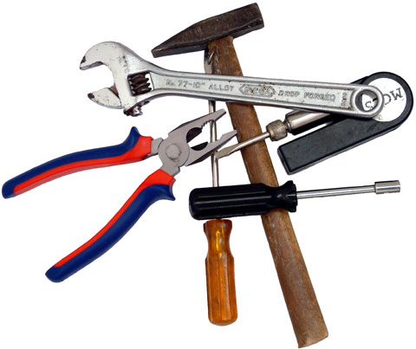
Limits of General Purpose Languages (2)
Not targeted to a particular kind of problem, but to any kinds of software problem.

Slide 14
Domain Specific Languages
Targeted to a particular kind of problem, with dedicated notations (textual or graphical), support (editor, checkers, etc.)
Promises: more « efficient » languages for resolving a set of specific problems in a domain

Slide 15
Domain Specific Languages (DSLs)
Long history: used for almost as long as computing has been done.
You’re using DSLs in a daily basis
You’ve learnt many DSLs in your curriculum
Examples to come!

Slide 16
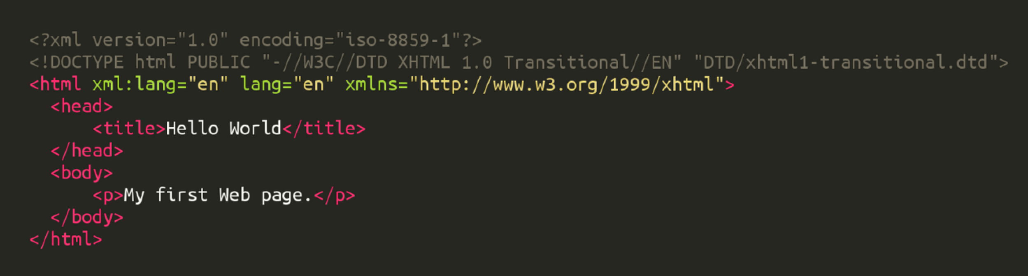
HTML
Domain: web (markup)

Slide 17
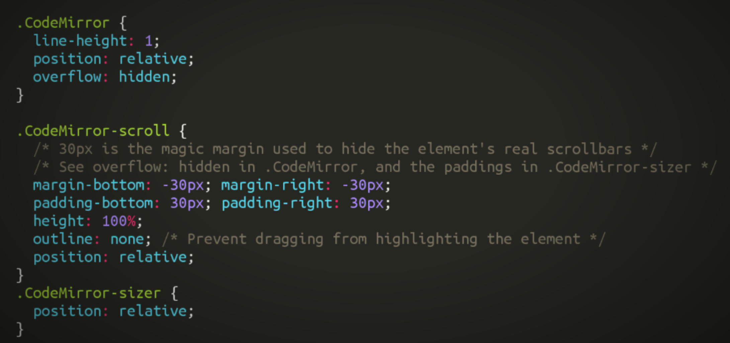
CSS
Domain: web (styling)

Slide 18
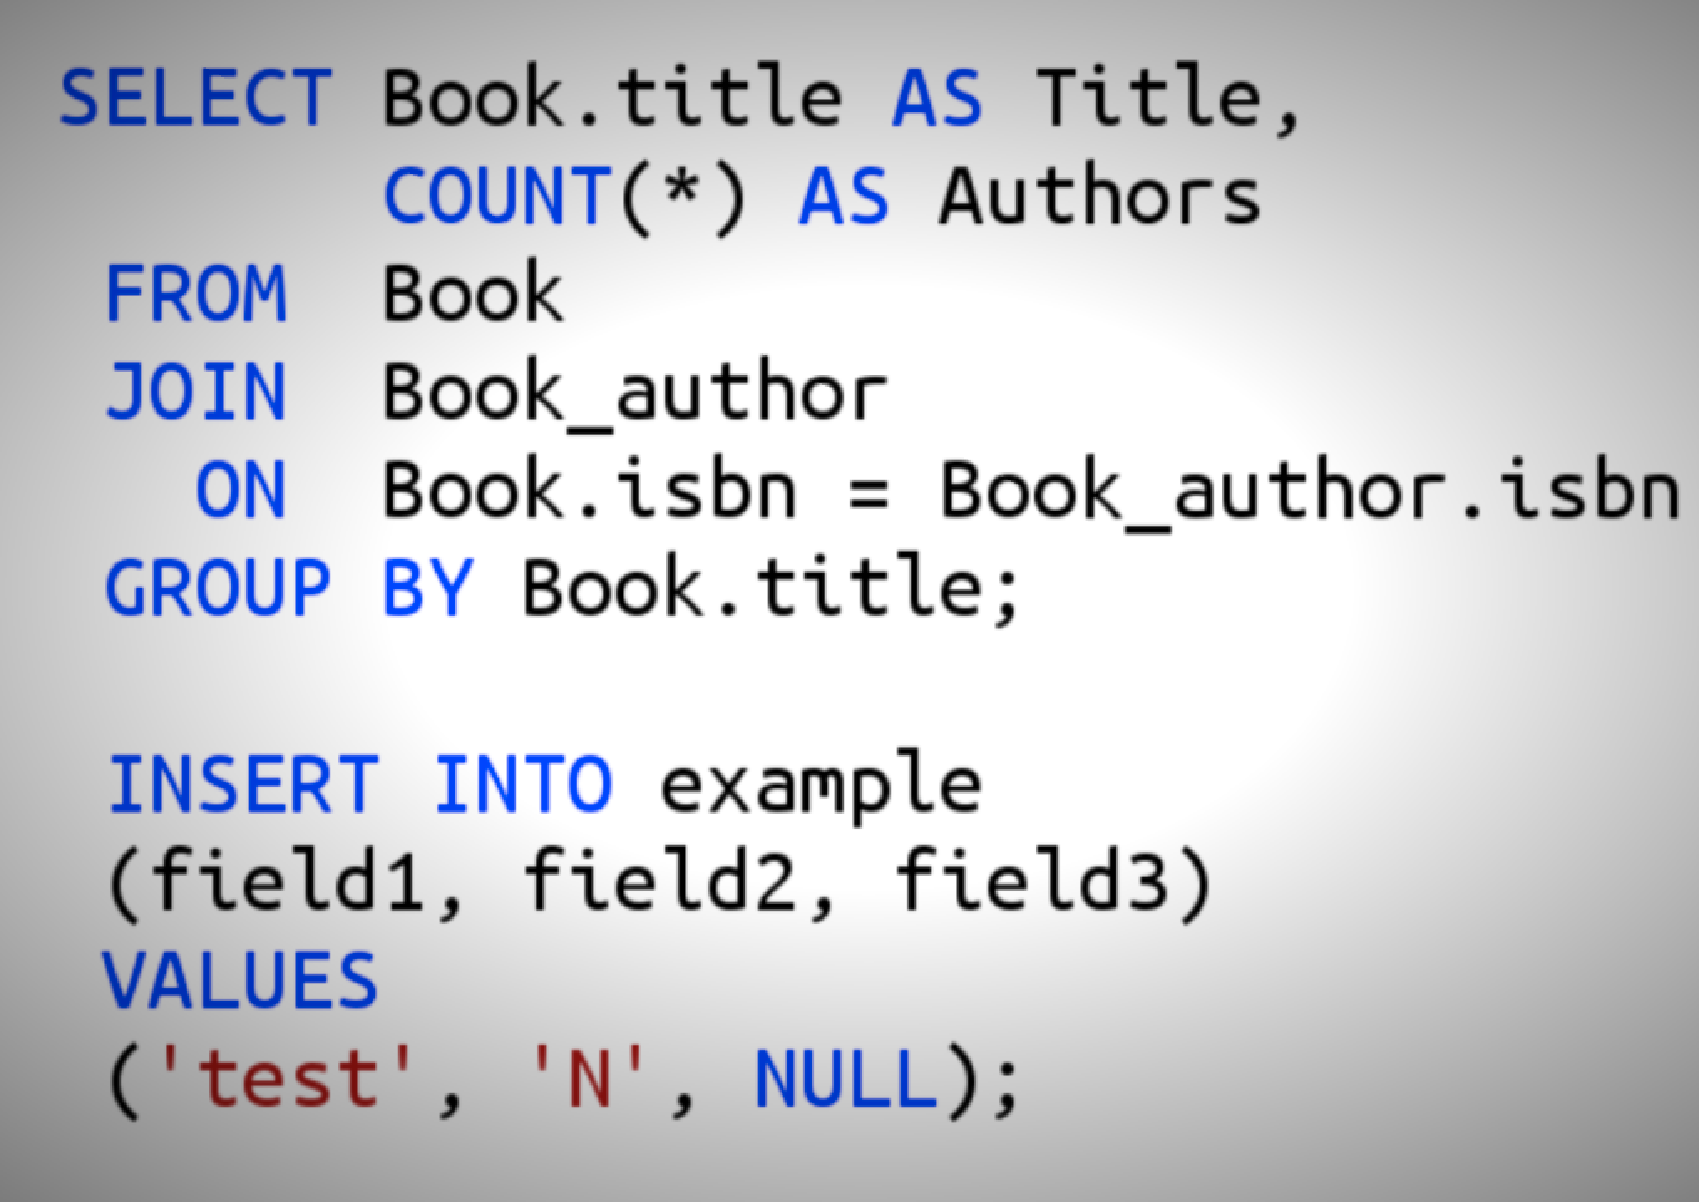
SQL
Domain: database (query)

Slide 19
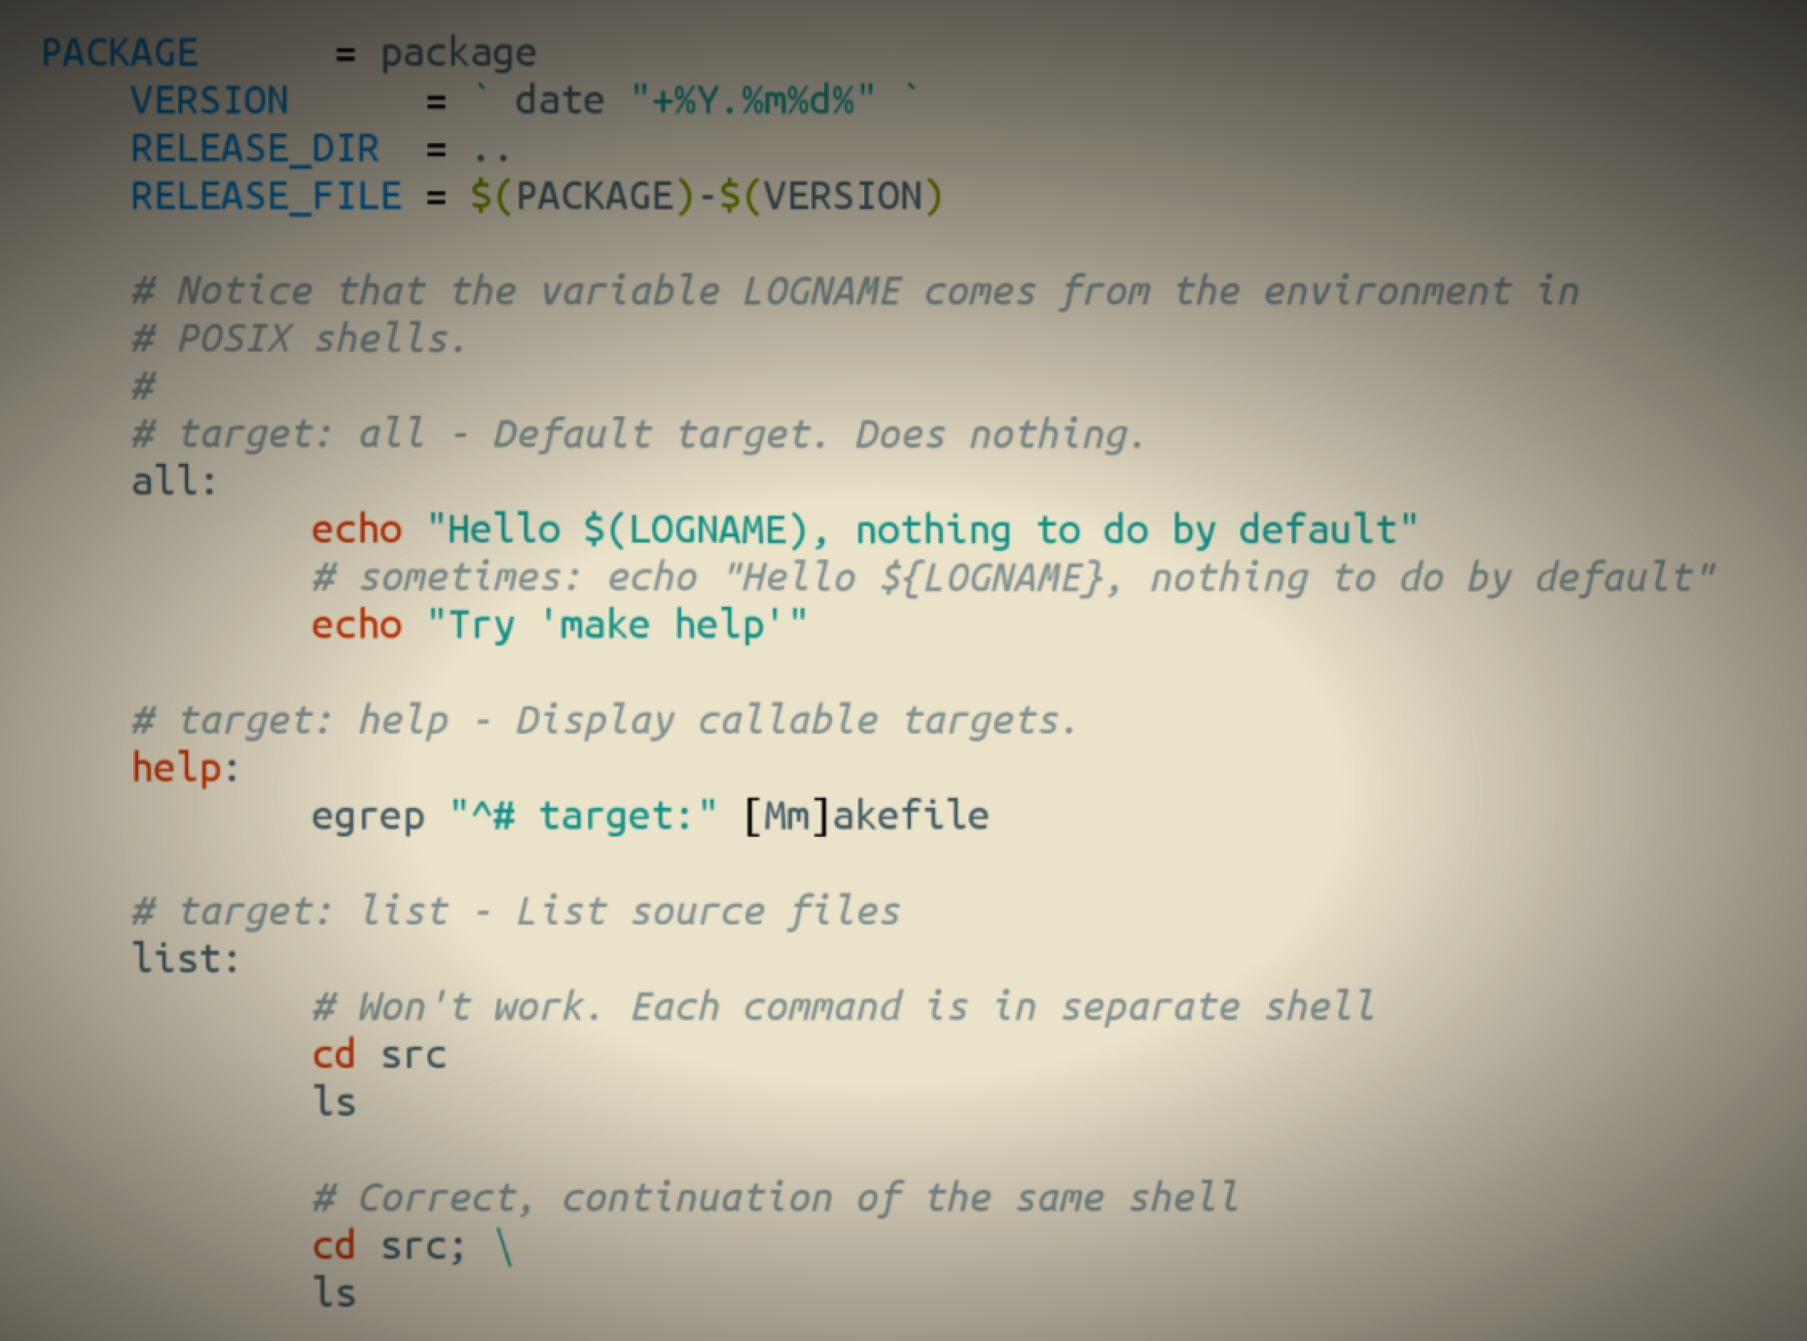
Makefile
Domain: software building

Slide 20
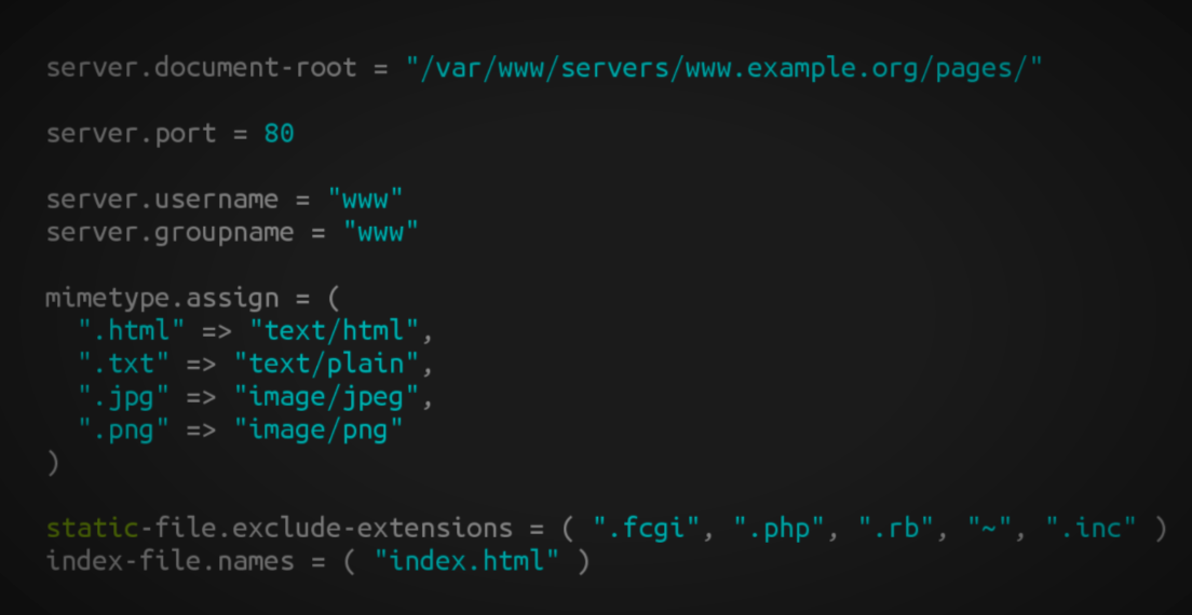
Lighthttpd configuration file
Domain: web server (configuration)

Slide 21
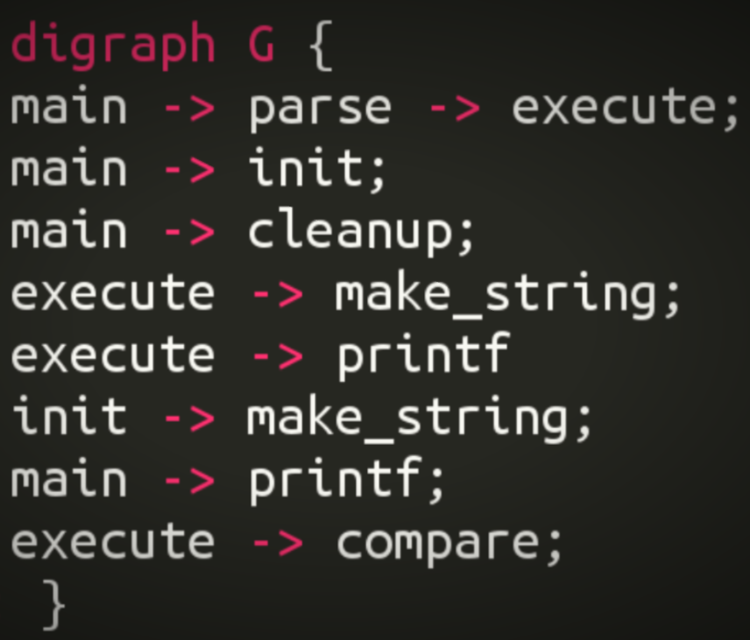
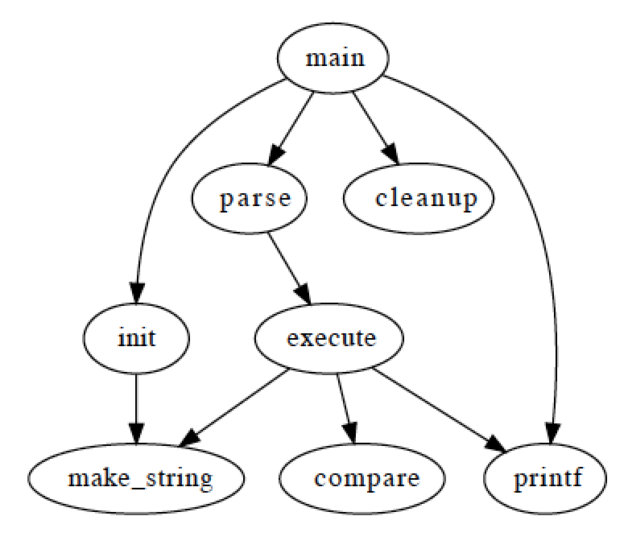
Graphviz
Domain: graph (drawing)

Slide 22
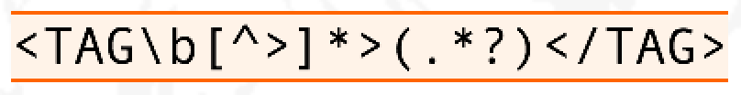
Regular expression
Domain: strings (pattern matching)

Slide 23
OCL
self.questions->size
self.employer->size
self.employee->select (v | v.wages>10000 )->size
Student.allInstances
->forAll( p1, p2 |
p1 <> p2 implies p1.name <> p2.name )
Domain: model management

Slide 24
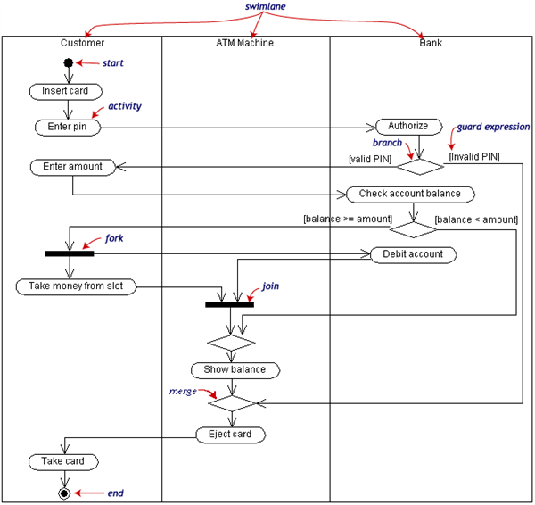
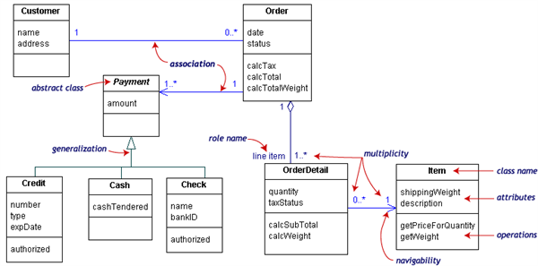
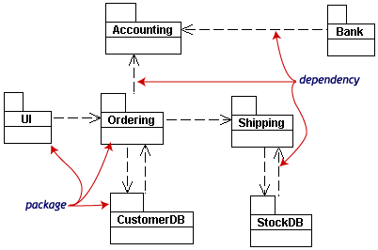
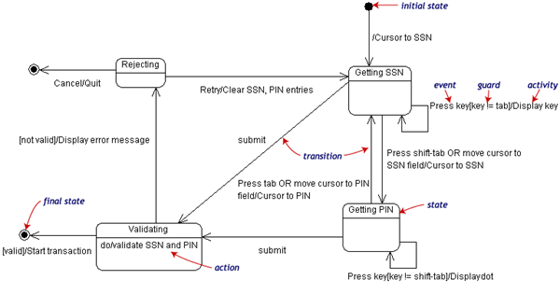
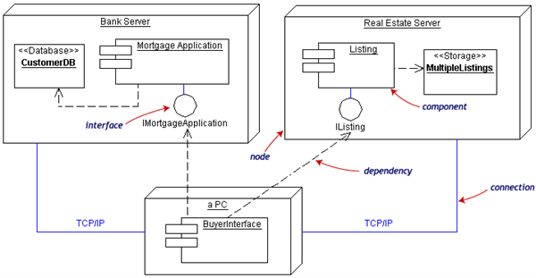
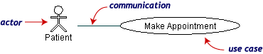
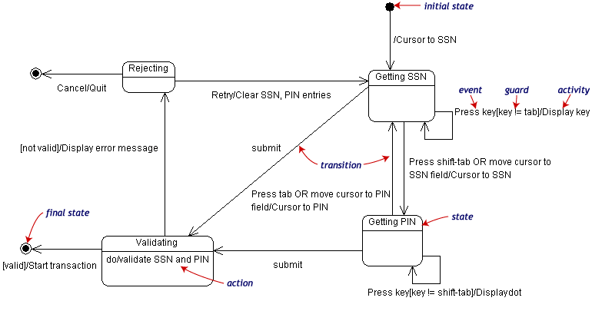
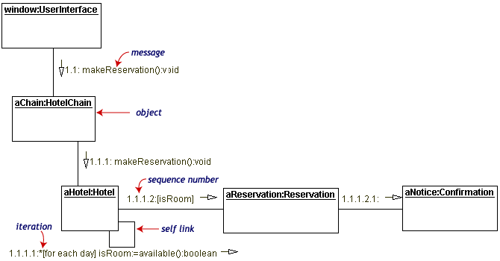
UML can be seen as a collection of domain-specific modeling languages
Structural
Behavioral

Slide 25
Defining languages

Slide 26
Software Language Engineering (SLE)
Application of systematic, disciplined, and measurable approaches to the development, deployment, use, and maintenance of software (domain-specific) languages
Supported by various kind of "language workbench"
Eclipse EMF, xText, Sirius, Melange, GEMOC, Papyrus
Jetbrain’s MPS
MS DSL Tools
Etc.
Various shapes and ways to implement software languages
External, internal or embedded DSLs, Profile, etc.
Grammar, metamodel, ontology, etc.
More and more literature, a dedicated Intl. conference (ACM SLE, cf. http://www.sleconf.org)…

Slide 27
Comparing Abstract Syntax Systems
Technology #1
(formal grammars
attribute grammars,
etc.)
Technology #2
(MOF + OCL)
Technology #3
(XML Meta-Language)
Technology #4
(Ontology engineering)
M³
A XML DTD
Or Schema
EBNF
MOF
Upper Level
Ontologies
M²
Pascal Language
Grammar
The UML
meta-Model
A XML
document
A XML DTD
or Schema
KIF
Theories
M¹
+Description
Logics
+Conceptual
Graphs
+etc.
A specific
Pascal Program
A Specific
UML Model
A XML
document
+ Xlink, Xpath, XSLT
+ RDF, OIL, DAML
+ etc.
A specific
execution
of a Pascal
program
A Specific
phenomenon
corresponding to
a UML Model
[XMI=MOF+XML+OCL]
(From J. Bézivin)

Slide 28
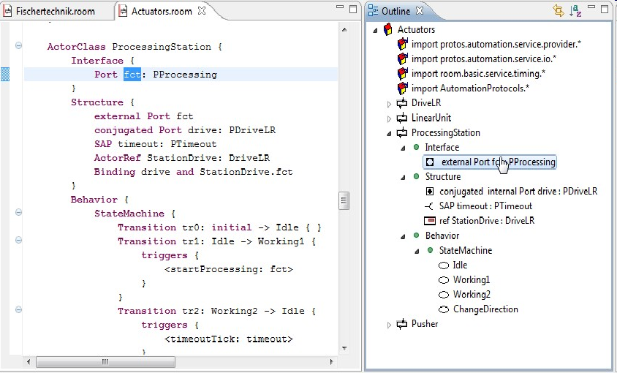
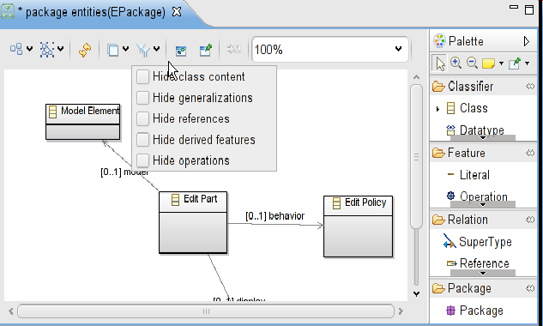
Bridging grammar/model space

Slide 29
Domain-Specific Languages (DSLs)
Targeted to a particular kind of problem, with dedicated notations (textual or graphical), support (editor, checkers, etc.)
Promises: more « efficient » languages for resolving a set of specific problems in a domain

Slide 30
Model-Driven Engineering (MDE)
Engineering Modeling Languages: Turning Domain Knowledge into Tools, by Benoit Combemale, Robert B. France, Jean-Marc Jézéquel, Bernhard Rumpe, Jim R.H. Steel, and Didier Vojtisek. Chapman and Hall/CRC, pp.398, 2016. Companion website: http://mdebook.irisa.fr

Slide 31
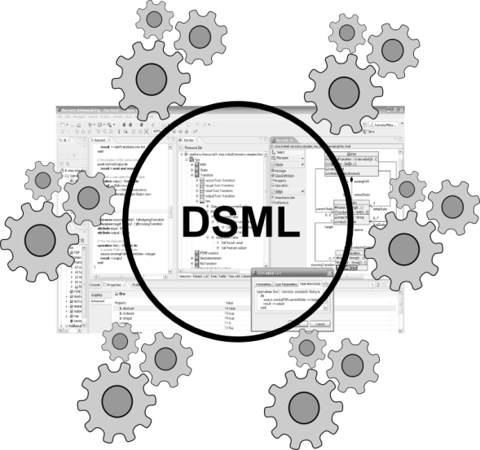
Model-Driven Engineering (MDE)
Editors
(textuals, graphicals, …)
Checkers
(static & dynamics)
Compilers
Test generators
Translators
Simulators
Code generators
Analyzers
Refactoring
Etc.
Engineering Modeling Languages: Turning Domain Knowledge into Tools, by Benoit Combemale, Robert B. France, Jean-Marc Jézéquel, Bernhard Rumpe, Jim R.H. Steel, and Didier Vojtisek. Chapman and Hall/CRC, pp.398, 2016. Companion website: http://mdebook.irisa.fr

Slide 32
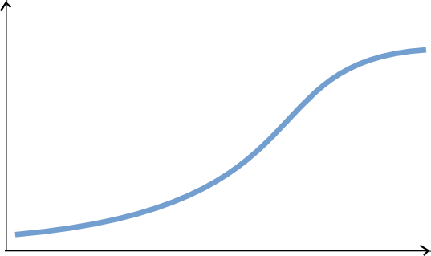
Complete environment
Large scale deploiement and distribution
Rich modeling tooling
(graphical, textuals, forms)
Live Collaboration « à la google doc »
Customisations
Large models
Parametric code generators
Documentation genetators
Analysis tools
Mission critical : tested and valided !
You are here
Lot of work
Some hours
Features

Slide 33
Automatisation facile
Basic editing features
Reflective and dynamic editors
Déploiement à travers le repo source (GIT..)
Collaboration classique
EMF compare
Code generation!
Lot of work
You are her
Some hours
Features

Slide 34
Content of the course
Introduction to MDE (from modeling to metamodeling)
Domain-Specific Languages
Model management (static analysis, code generators)
Experimentations with the Eclipse Modeling Framework (incl. Ecore and OCL), Xtext, Sirius and Xtend

Slide 35
You will learn how to
Automatically translate abstract design models to executable code, test cases and documentation
Automatically manipulate your model/code to analyze and refactor it
Build or customize your own abstractions, or even software languages and development environments, to build complex, domain-specific, software-intensive systems
Eventually limit the accidental complexity of industrial processes developments

Slide 36
Additionally, you will also
Demystify language formalisms, paradigms and principles
Have a deeper insight on some of them
Manage the industrial complexity of developments and associated toolchains

Slide 37
Eclipse plugin structure and lifecycle
integrated development environment with base workspace and an extensible plug-in system
Contribute to existing IDE
Open structure with thirdparty contributions
Update site, market place, …
Or create your own application
Rich Client Platform (RCP) for developing general purpose applications
-> component based / service base approach
Equinox : an implementation of OSGI core framework
Ie. Pick in the huge community plugins to build your application

Slide 38
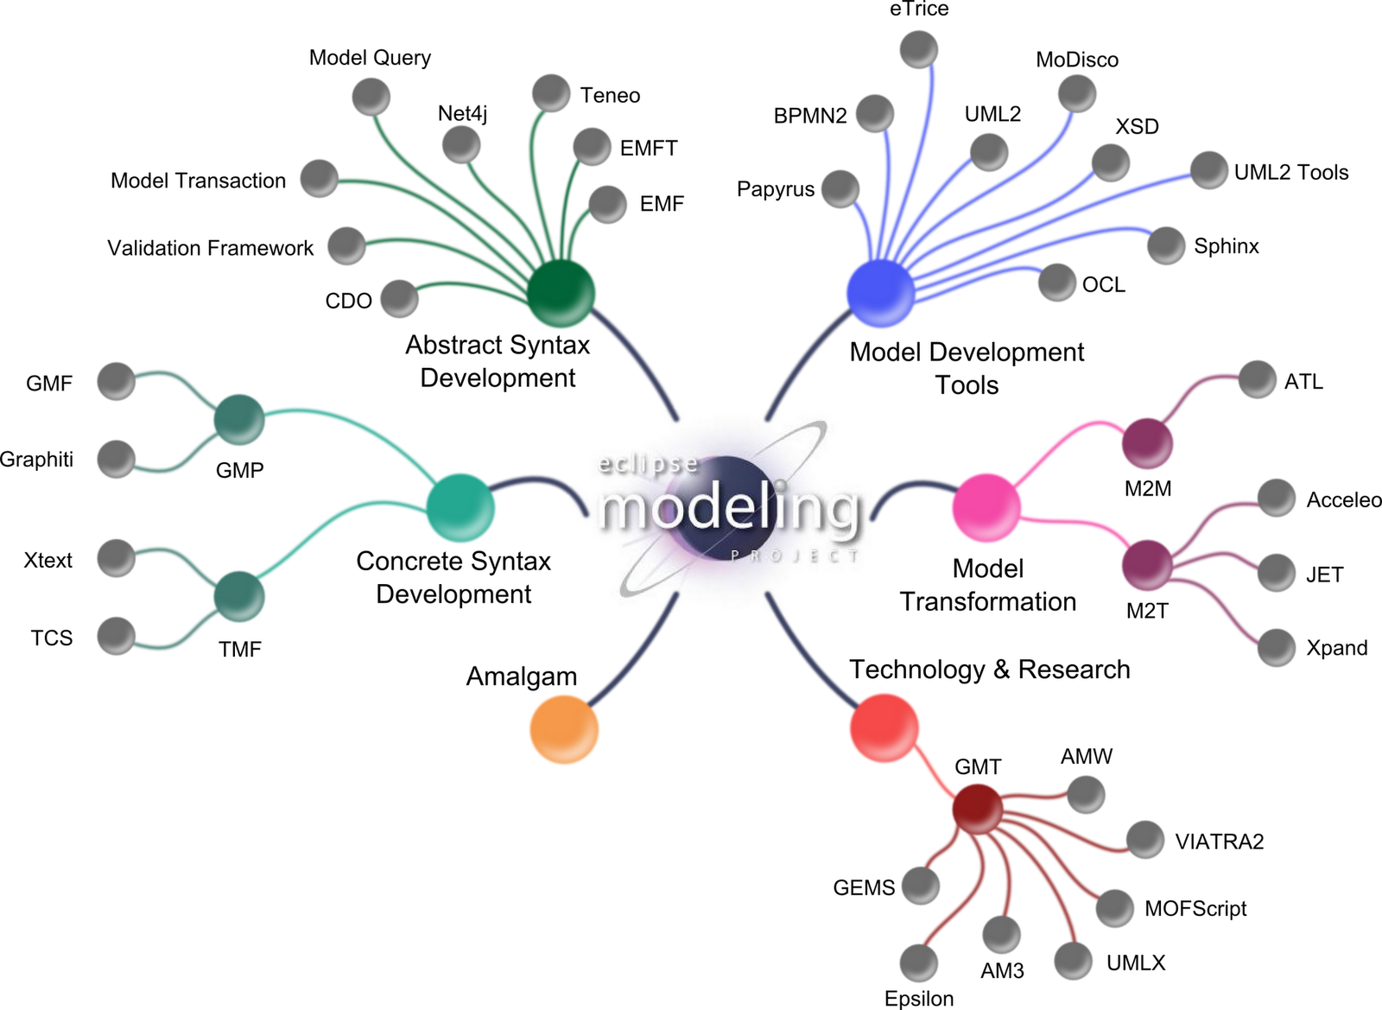
Eclipse Modeling Project
GEMOC

Slide 39
Ecore/EMF
EMF serves as the foundation: It provides the Ecore meta-metamodel (basically a Class diagram ), and frameworks and tools around it :
EMF provides almost for free (among other features)
serialization (XMI)
Tree editor
either reflective, or generated with possibility to customize
Edition support (outline, notification API for other editors, …)
Java manipulation API
EMF compatible projects use this as a base to propose extended services

Slide 40




Farming Modeling: metamodeling approach
Language Engineers
Language Users
Viewpoint
(graphical editor)
Grammar
(textual editor)
Behavioral
semantics
(animator)
Domain
Globalization,
execution,
simulation and
animation
Data
Views and
static checking
Textual editing and
static checking

Slide 41
Farming Modeling: metamodeling approach
Language Engineers
Language Users
Domain
Data

Slide 42
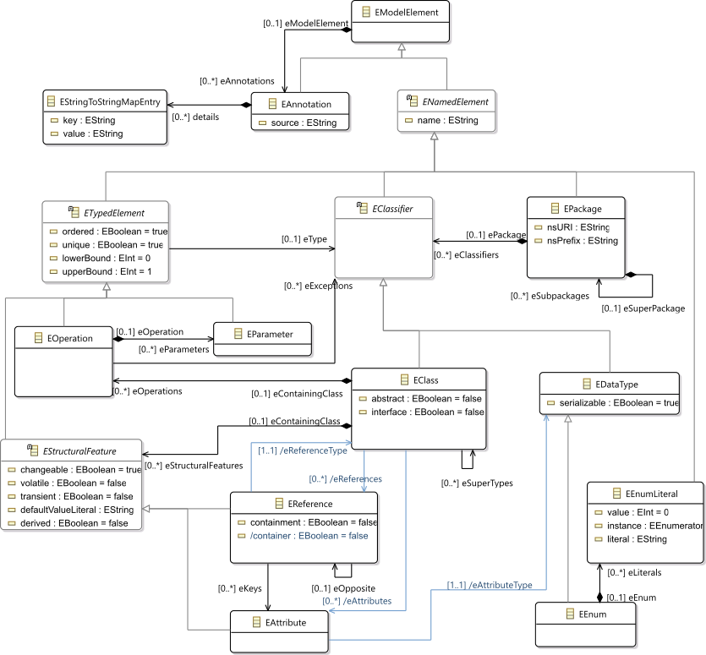
Ecore most used concepts
(ie. Removed most helper derived features, operations and generic support)

Slide 43
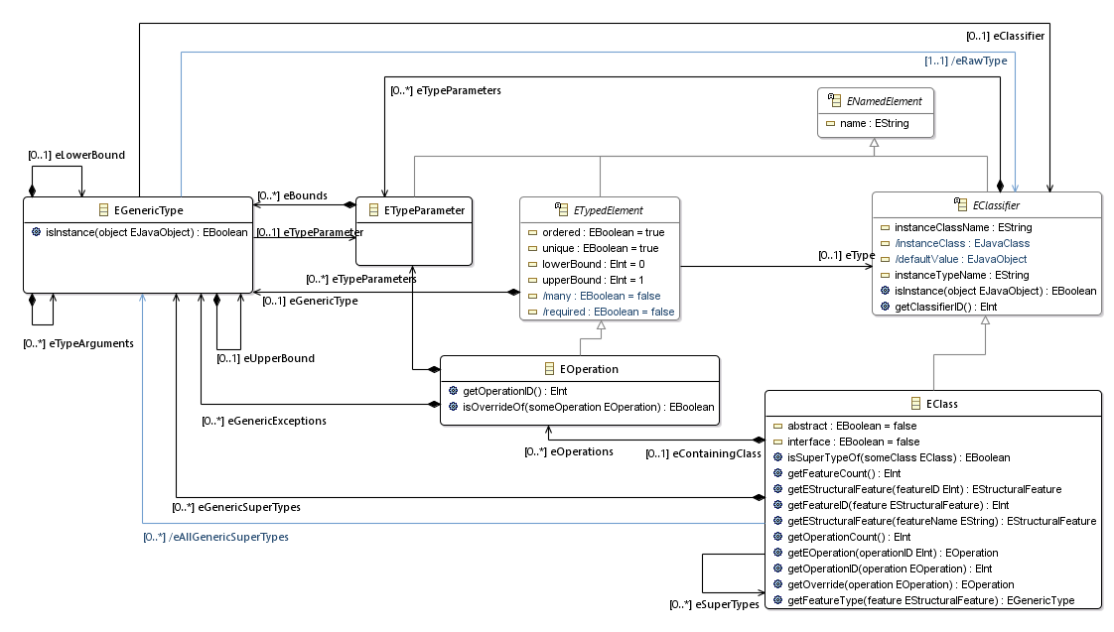
Ecore extended usage
Support of generics
TODO Add usage picture in the tree editor

Slide 44
Design your domain
Using the Ecore tree editor (EMF)
Using the graphical editor (Ecore tools)
Using a textual editor (oclinecore, …)

Slide 45
Containment
A metamodel is not only a graph
Containment information is used by many tools to provide "smart" default implementations
Tree editor, textual syntaxes, graphical syntaxes, …
Impact on model manipulation/transformation

Slide 46
Graph with constraints : assignment example
Composition
Association
A
b
B
C
c
d
D
0..1
1
*
container()
c
a1:A
b
b1:B
c1:C
d
d1:D
a2:A
d2:D
a2.b := b1
d2.c := c1
a1:A
b
b1:B
c1:C
d
d1:D
c
a2:A
container()
d
d2:D

Slide 47
OCL
Class diagram structure implies design choices
Inviariant (written in OCL for ex) can complement it in order to enforce the consistency of models

Slide 48
Basic tree editor
For free with EMF
Structure also used as outline for other editors
Customizable via
genmodel
replacement of default icons
Modification of the generated code
For example for custom labels or conditionnal icons
Do not forget to add "generated NOT" in the method comment

Slide 49
Metamodeling approach
Language Engineers
Language Users
Grammar
(textual editor)
Domain
Data
Textual editing and
static checking

Slide 50
M³
EBNF
Metametamodel
Grammar
Metamodel
M²
M¹
Source
Code
Model

Slide 51

Give me a grammar,
I’ll give you (for free)
* a comprehensive editor (auto-completion, syntax highlitening, etc.) in Eclipse
* an Ecore metamodel and facilities to load/serialize/visit conformant models (Java ecosystem)
* extension to override/extend « default » facilities (e.g., checker)

Slide 52

Xtext, Grammar, Metamodel
Xtext, Grammar, Metamodel
Grammar
Metamodel
conforms To
conforms To
Source Code
A
Model A

Slide 53
Metamodeling approach
Language Engineers
Language Users
Grammar
(textual editor)
Viewpoint
(graphical editor)
Domain
Data
Textual editing and
static checking
Views and
static checking

Slide 54
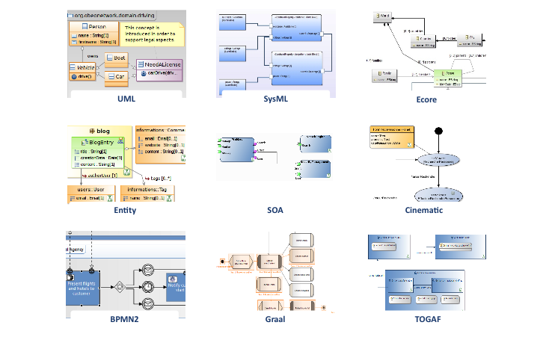
Sirius: Examples of Viewpoints
….

Slide 55
Metamodeling approach
Language Engineers
Language Users
Grammar
(textual editor)
Viewpoint
(graphical editor)
Behavioral
semantics
(animator)
Domain
Views and
static checking
Globalization,
execution,
simulation and
animation
Textual editing and
static checking
Data

Slide 56
Add behavior / write transformation
This is usually a traversal task navigating in the model in order to perform some actions in one or more pass
Adding operations (with "generated NOT") in the ecore gives a nice structuration based on the metamodel concepts
BUT this breaks the separation of concern requirement
Traditional approaches : visitor design pattern
EMF proposes in the model java implementation a pre built variant of the visitor pattern : switch
However, it doesn't scale up very well in case of multiple metamodels; and is

Slide 57
Kermeta
Can be considered as an advanced visitor pattern but with an aspect oriented syntactic sugar
Ie. The programmers see the classes as if they where "reopened" and extended
Extension supports new operations but also new attributes, new association or new inheritance

Slide 58
Melange
2 roles:
Language definition,
Compose languages part in order to build language implementation

Slide 59
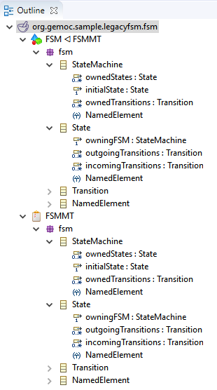
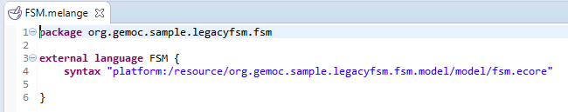
Melange simpliest example
Define a language based on an ecore
Everything is in a single ecore
The model type (MT) is equal to the ecore

Slide 60
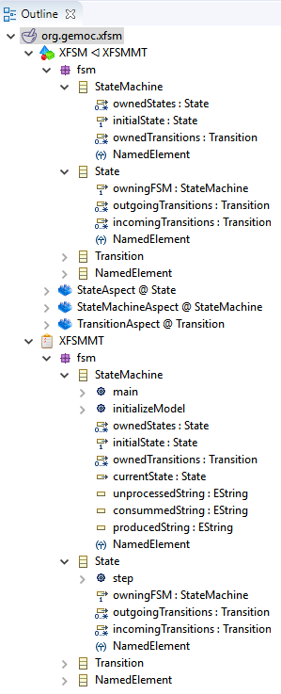
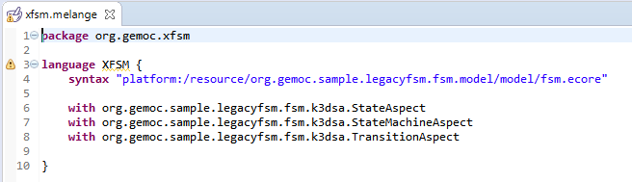
Melange – Combining language parts
Adds operation and attributes
may add new concepts too by using multiple ecore files (possibly with operator such as slice)
Melange generates the new resulting implementation
We may consider only the result to build additional tooling and ignore the initial parts (which have been copied in the new runtime)

Slide 61


Melange – language relation
Inheritance (implicit or explicit)
Support for convertion services (adapter)
An XSFSM model can be processed by transformation written for FSM
A FSM model can be loaded as XSFSM
Adapter mechanism provides an equivalent to a "downtype copy" but working on the actual FSM model
Must take care to default values
Editor may be written on FSM and animator on XSFSM

Slide 62
My 3 take away messages
#1 DSLs are important (as intuited for a long time – it will become more and more apparent)
#2 DSL technology is here (no excuse)
#3 MDE meets language engineering

Slide 63
But my take away message is NOT
That DSLs should be used systematically, in every situations

Slide 64
Worst practices
When Developing DSLs?
Tradeoff cost/time of development versus producivity gained for solving problems
If you use your DSL for resolving one problem, just one time, hum…
DSL: reusable, systematic means to resolve a specific task in a given domain
DSL development can pay off quickly
5’ you can get a DSL
But DSL development can be time-consuming and numerous worst practices exists

Slide 65
Worst practices
Worst Practices
Initial conditions
Only Gurus allowed
Believe that only gurus can build languages or that “I’m smart and don’t need help”
Lack of Domain Understanding
Insufficiently understanding the problem domain or the solution domain
Analysis paralysis
Wanting the language to be theoretically complete, with its implementation assured

Slide 66
Worst practices
Worst Practices
The source for Language Concepts
UML: New Wine in Old Wineskins
Extending a large, general-purpose modeling language
3GL Visual Programming
Duplicanting the concepts and semantics of traditional programming languages
Code: The Library is the Language
Focusing the language on the current code’s technical details
Tool: if you have a hammer
Letting the tool’s technical limitations dictate language development

Slide 67
Worst practices
Worst Practices
The resulting language
Too Generic / Too Specific
Creating a language with a few generic concepts or too many specific concepts, or a language that can create only a few models
Misplaced Emphasis
Too strongly emphasizing a particular domain feature
Sacred at Birth
Viewing the initial language version as unalterable

Slide 68
Worst practices
Worst Practices
Language Notation
Predetermined Paradigm
Choosing the wrong representational paradigm or the basis of a blinkered view
Simplistic Symbols
Using symbols that are too simple or similar or downright ugly

Slide 69
Worst practices
Worst Practices
Language Use
Ignoring the use process
Failing to consider the language’s real-life usage
No training
Assuming everyone understands the language like its creator
Pre-adoption Stagnation
Letting the language stagnate after successful adoption

